Slide 1
Flight Delay Predictions
W261 Machine Learning at Scale
Team 2: Jorge Hernandez, Bo Qian,
Devin Robison, Demian Rivera

Slide 2
Business Case
Given the complex logistics and congestion in the airline industry as a result of weather and non-weather related events and its impact on travel profitability, it has become increasingly important to more accurately predict flight delays in order to increase customer satisfaction, and thereafter customer loyalty.
We believe that customers care more about arrival delay than departure delay and given that a significant amount of delayed time is made up by pilots in the air, we have decided to focus on predicting flight arrival time delay, which we believe is more associated with a negative customer experience.
Notes:
[Demian]

Slide 3
Dataset and Models
We set out to explore and analyze a flight delay datasets containing data from 2015-2019 for all major airports in addition to an extensive weather pattern dataset. We also used a subset of only 2015 data for Data Preparation, Feature Engineering, Experimentation, and Modeling, which we plan to go into a little more depth next.
We mainly use Precision and Recall to compare four different modeling methodologies used:
Logistic Regression
Decision Tree
Random Forest
XGBoost
Notes:
[Demian]

Slide 4
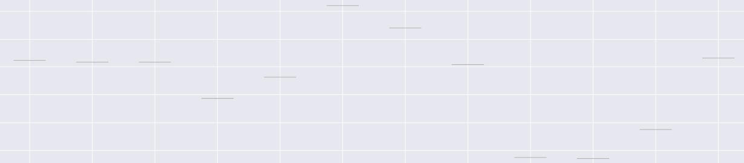
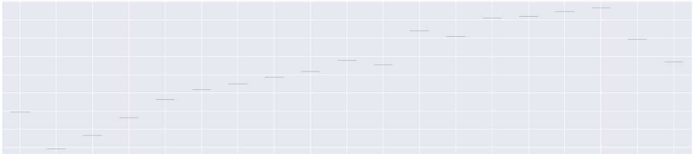
Exploratory Data Analysis
x
Month
x
x
x
x
x
x
x
x
June
July
Aug
x
x
x
x
x
x
x
Time
x
x
x
x
x
x
x
x
x
x
x
x
x
x
16:00
22:00
x
Notes:
[Demian]

Slide 5




Data Engineering: Training Data Creation
Notes:
[Devin]
For this project, we have three primary data sets and one auxiliary data set
Primary data sets consist of airline flights logged between 2015 and 2019, a weather data set consisting of periodic weather measurements from a variety of weather stations, and a weather station data set which contains information about individual stations across the world, including latitude and longitude coordinates.
The auxiliary data set contains listings of world airports, along with their latitude and longitude values.
Here I’ll go over the high level stages for one of the primary data engineering tasks: construction of the final data aggregations from which our training and test data will be drawn
Data frame construction has three major components
Pruning data we know is not useful
Matching airports with their nearest weather station
Matching flights with any corresponding weather reports within some specified time window.

Slide 6
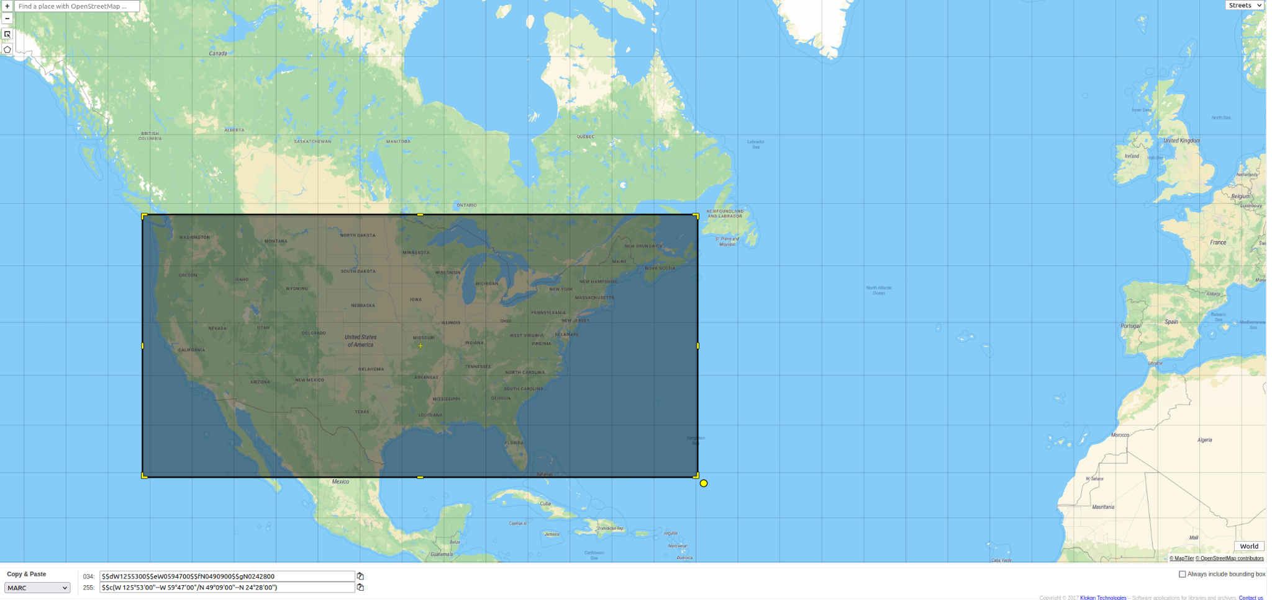
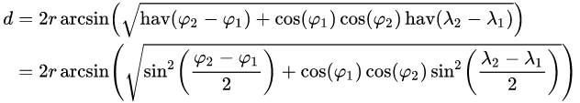
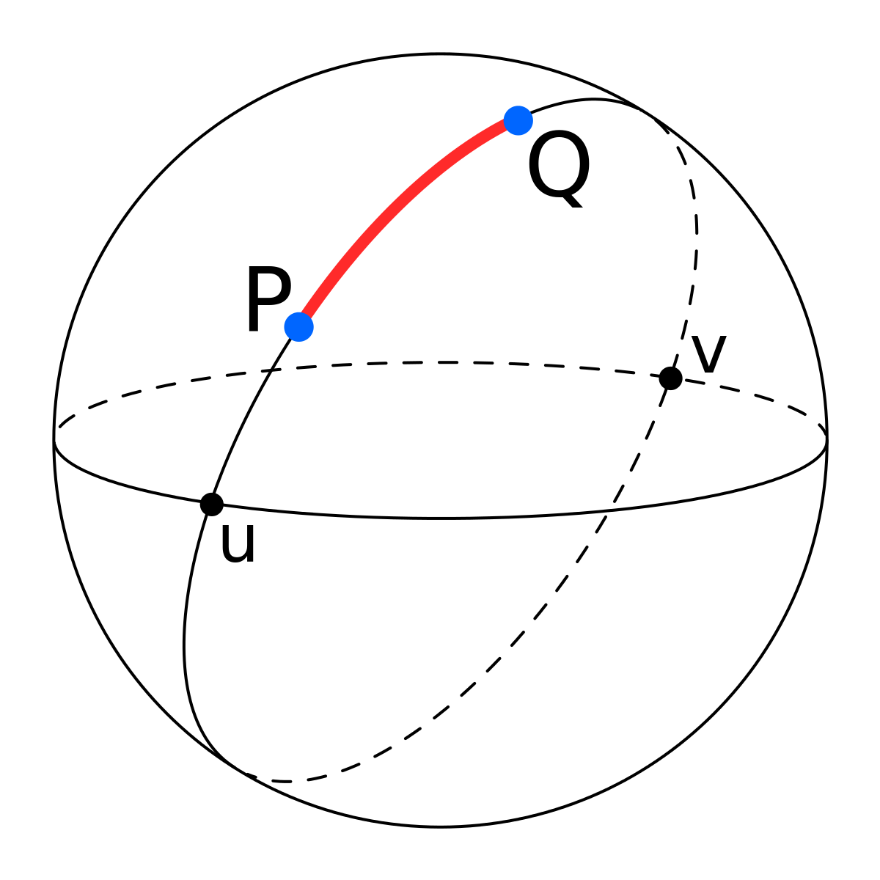
Data Pruning and Station Matching
Filtering Data
Geographic filtering makes flight, weather, and airport data significantly more manageable (also quick and embarrassingly parallel).
Outer joins to get all airport/station pairs.
Partitioning (windowing) on individual airports
Selecting row with minimum Haversine distance between airport and station.
Station Matching
Notes:
[Devin]
We start with geographic filtering, which requires a full pass through the data, but results in significantly more manageable data sizes
Very important for things like outer joins which can cause data size to explode
After filtering, we need to match each airport with its nearest weather station.

Slide 7
Time Windows and Weather Data
Augmenting Flight Data
Aggregating Weather Events
Join flights with their DEP and ARR stations.
Attach time windows to each flight that indicate the span of weather events to aggregate.
Outer join weather events to flights based on:
Station Equality
Weather Event in Flight Time Window
GroupBy FlightData and mean aggregate weather conditions.
Results
Final process is quite fast
~ 1 hour 50 minutes including pruning, feature engineering, and final flight + weather aggregation for the full data set.
All our required data are in a single dataset!
Notes:
[Devin]

Slide 8
Visual Overview
Window:Airport:A
Station | Lat | Lon | Airport | Lat2 | Lon2 | Haversine | Row
1 | 36 | -121.233 | A | 33.64 | -84.42 | 100.123 | 1
2 | 70.33 | -149.59 | A | 33.64 | -84.42 | 300.123 | 2
CrossFilter Table
Station | Lat | Lon | Airport | Lat2 | Lon2 | Haversine
1 | 36 | -121.233 | A | 33.64 | -84.42 | 100.123
1 | 36 | -121.233 | B | 41.979 | -87.90 | 400.546
2 | 70.33 | -149.59 | A | 33.64 | -84.42 | 300.123
2 | 70.33 | -149.59 | B | 41.979 | -87.90 | 200.465
Window:Airport:B
Station | Lat | Lon | Airport | Lat2 | Lon2 | Haversine | Row
2 | 70.3 | -149.59 | B | 41.97 | -87.90 | 200.465 | 1
1 | 36 | -121.233 | B | 41.97 | -87.90 | 400.546 | 2
Nearest Pairs
Station | Lat | Lon | Airport | Lat2 | Lon2 | Haversine | Row
1 | 36 | -121.233 | A | 33.64 | -84.42 | 100.123 | 1
2 | 70.3 | -149.59 | B | 41.97 | -87.90 | 200.465 | 1
Notes:
[Devin]

Slide 9
Visual Overview
df_flights_aug
df_weather
GroupBy Flight Columns
Mean-Aggregate
Weather Columns
Station | Date | Flight#
Station | Date | ....
Flight# | ... | Weather1 | Weather2 | Weather2 | ….
1
2
3
4
...
N
Left-Outer Join
Flight# | Date | Weather1 | Weather2 | Weather2 | ….
1 | …. | ... | ... | ...
1 | …. | ... | ... | ...
Notes:
[Devin]

Slide 10
Label
Features
Chosen Columns
Month, Day-of-week
Departure and arrival time block
Is_Rush_hour, Is_Rush_month
Height of clouds(cid_height)
Dew point
Sea Level Pressure
Temperature
Visibility Distance
Wind Angle and Speed
Carrier Codes
Airports
Binary indicator of Arrival Flight delayed by 15 mins or more
Notes:
[Jorge]
The information we decided to use to build our models are: as the label, a binary indicator for flights arriving late by 15 minutes or more
And for the features, time variables like month and day of the week
The time blocks for the departure and arrival flights
Binary indicators for rush month and hour
Weather variables of height of the clouds, dew point, sea level pressure, temperature, visibility distance, and wind speed and angle
And Carrier and airports id
We thought that these pieces of information gave a good estimation of whether a flight may experience delay within a respectable time frame before the arrival time.

Slide 11
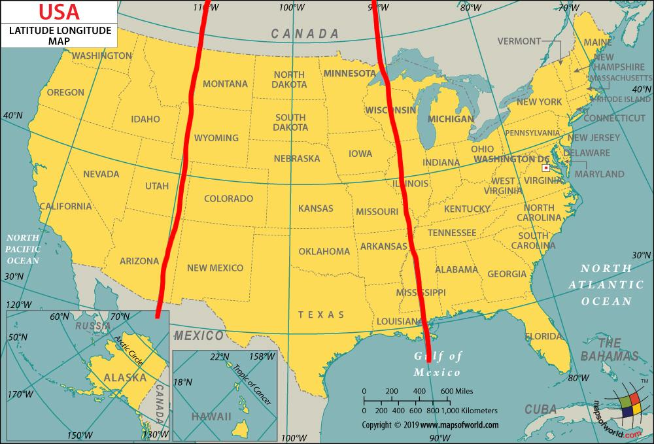
Feature Engineering
Numerical | Categorical
Min-Max Scaler | Dummy Variables * Carrier ID Grouping Variables * Airport ID
Decided to remove all columns with nulls
Notes:
[Jorge]
All the features we chose fall into two types, numerical and categorical.
The numerical features were scaled with a min-max scaler so that each feature has the same range and therefore the same effect on the model
As for the categorical features, we took two approaches depending on the amount of categories in that feature
For example, airlines contained 19 unique values while airports contained 371.
For the features with smaller numbers of categories, we used dummy variable representation since they are a simpler way of understanding the effects of the category values' influence on the model.
On the other hand, with features of larger variation we grouped the categories values, such as with airports we based the groups by their geographical location.
The airports were split into 3 groups: West, Mid, and East based on longitudinal coordinate
This helped to cut down the number of variables but still leaves some representation of the effects of a specific area.
Also to save us from additional trouble we decided to drop all the records containing nulls since there were plenty of complete records left

Slide 12
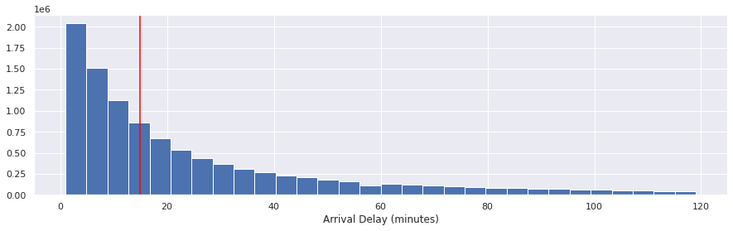
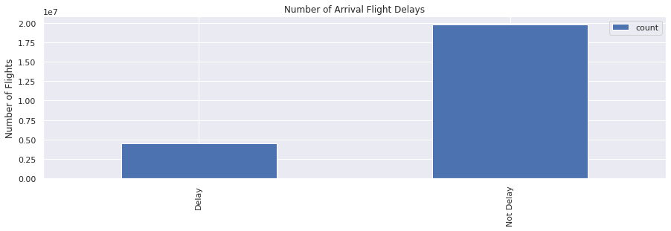
Data Train/Test Split
Train
Test
2015
2016
2017
2018
2019
Notes:
[Jorge]
For splitting the data for training and testing, we took the simplest approach which was based on year.
We seperated one whole year as test from the 5 available years
This help to prevent the model from possibly overlooking any seasonal trends
But before conducting any training of the models, we had to address another issue involving the Label
The variable contained way more instances of no flight delays or negative hits compared to instances of flight delay or positive hits
This issue was therefore drowning out the signal we were training on
So to address this, we decided to use undersampling to sample the negative hits to match that of the positive hits for delays in the training set
Now Bo will talk about our model approaches.

Slide 13
Model | Precision | Recall | F1 | Accuracy
LogisticRegression | 87.57% | 60.07% | 64.91% | 60.54%
LogisticRegression (Enet + GS + CV) | 88.06% | 56.78% | 63.14% | 58.54%
DecisionTree (GS + CV) | 88.25% | 59.18% | 64.75% | 60.35%
RandomForest (GS + CV) | 89.42% | 64.69% | 68.81% | 65.01%
XGBoost (GS + CV) | 89.89% | 75.89% | 75.68% | 73.42%
Notes:
[Bo]
We included 5 models as in this table. So first is a plain-vanilla LR, and then a optimized LR using Enet/GS/CV, and also a DecisionTree/RandomForst/Xgboost. These were all using GS and CV.
Our primary matrix are precision and recall. Because we think from passenger perspective, they will mainly care about precision; from airline company perspective, they would care more about recall. But we also compared the accuracy and F1 for our information.
Among all the models, XGBoost is having the best performance on every matrix.The precision is about 90%, Recall is about 75%, and a 73% F1. The RandomForest is less performant, having a 70% precision, 34% recall and 34% F1. For the rest of three models, their precision is all around 88%, recall around 59%, and around 60% of F1.
But from a scalability perspective, we do noticed that the run time for different models are different. For the first 4 models, their run time is generally from several minutes to 1.5 hours, but the XGboost was taking more than 6 hours to run.
So this actually leads to another topic, the biggest challenge we have during this project, which is the limited computational resources.

Slide 14
Biggest Challenge
Computational Resources!
Notes:
[Bo]
For example the merging process of the airlines/weather dataset took about 1.5hours to run, even if our airlines/weather datasets were already reduced before merging. And after we were attempting to write the merged dataset to the storage for easier access, it could take several hours depending on if there is any other tasks running at the same time. Another representation of the limited computational resources is when we were all working together at the same time in different notebooks, the run time of the functions will take significantly longer. But this experience is actually very useful because in real world, the computational resources are generally always limited, so how to handle this is definitely something we need to take into consideration.

Slide 15
Future Work
DEP_DEL15
More Features
More Recent Data
Other Models
Notes:
[Bo]
So if we could have more time, what are some of the future works we would want to explore. First is to predict departure delay to give a notification to the passengers before the departure. That’s originally in our plan, but we eventually abandoned that idea out of the limitation of time.
Also we could include more features, for example YEAR, to see if it will impact the model because different year may have different trends on delay.
Also we are using 2015~2019 data, but if we could access more recent data, we can maybe look into how COVID is impacting flight delays.
And last but not least, explore other models to see if we can get a even better performance.
So that’s pretty much all of our presentation today. For more details, please refer back to our final notebook. We are now open for any questions.

Slide 16
Thank you!

